Slide 1
Trojan Map
EE 538 - Final Project

Slide 2
OUTLINE
Self-Implementation
Auto Complete Name / Closest name / Find Location
Bellman Ford Shortest Path
Dijsktra Shortest Path
Travelling Salesman Problem

Slide 3
SELF-IMPLEMENTATION

Slide 4
Given names, find their location information.
Using Binary Search !!!
Time: O(logn)
Space: O(n)
<Location Name 1>
<Node Info 1>
<Location Name 2>
<Node Info 2>
<…>
<…>
<Location Name n>
<Node Info n>

Slide 5
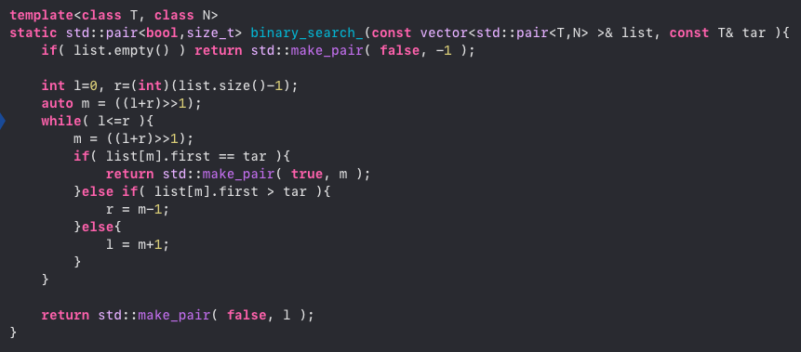
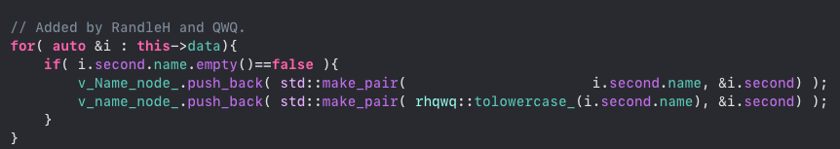
Given names, find their location information.
Using Binary Search !!!
Step 1: Find the node that has a valid name.
Step 2: Sort the array of name first.
Step 3: Apply binary search
Step 4: If the name doesn’t exist, find the nearest one (The one you will insert the name before that).

Slide 6
The following functions all used Binary Search !!!
std::string GetID(const std::string& name);
std::vector<std::string> Autocomplete(std::string name);
std::pair<double, double> GetPosition(std::string name);
std::string FindClosestName(std::string name);
std::vector<std::string> CalculateShortestPath_Dijkstra
(std::string location1_name, std::string location2_name);
std::vector<std::string> CalculateShortestPath_Bellman_Ford
(std::string location1_name, std::string location2_name);

Slide 7
OUTLINE
Self-Implementation
Auto Complete Name / Closest name / Find Location
Bellman Ford Shortest Path
Dijsktra Shortest Path
Travelling Salesman Problem

Slide 8
AuTO-Complete & Find Location

Slide 9

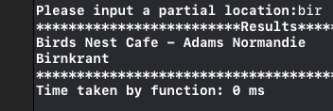

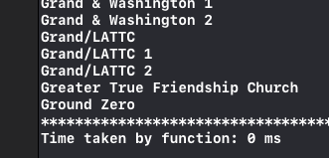
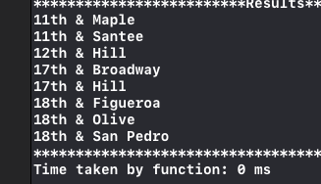
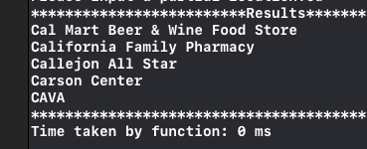
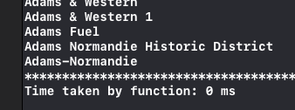
Auto-Complete
Here are some results for auto-completetion.
Time: O(logn)
Input: ”bir”
Input: ”yu”
Input: ”g”
Input: ”1”
Input: ”Ca”
Input: ”Ada”

Slide 10
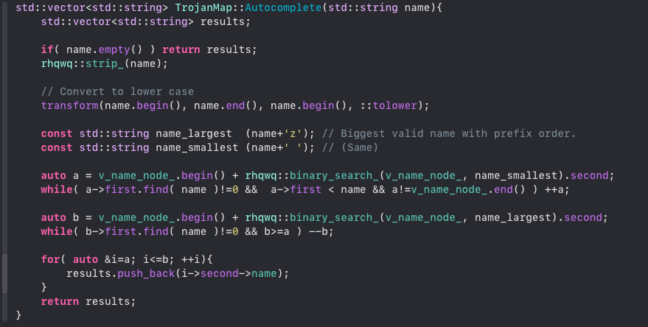
Auto-Complete

Slide 11
Find Location QWQ
Here are some results for finding a location.
Time: O(logn)
Input: ”bir”
Input: ”yu”
Input: ”g”
Input: ”1”
Input: ”Ca”
Input: ”Ada”

Slide 12
Closest Name QWQ

Slide 13
OUTLINE
Self-Implementation
Auto Complete Name / Closest name / Find Location
Bellman Ford Shortest Path
Dijsktra Shortest Path
Travelling Salesman Problem

Slide 14
BELLMAN-Ford

Slide 15
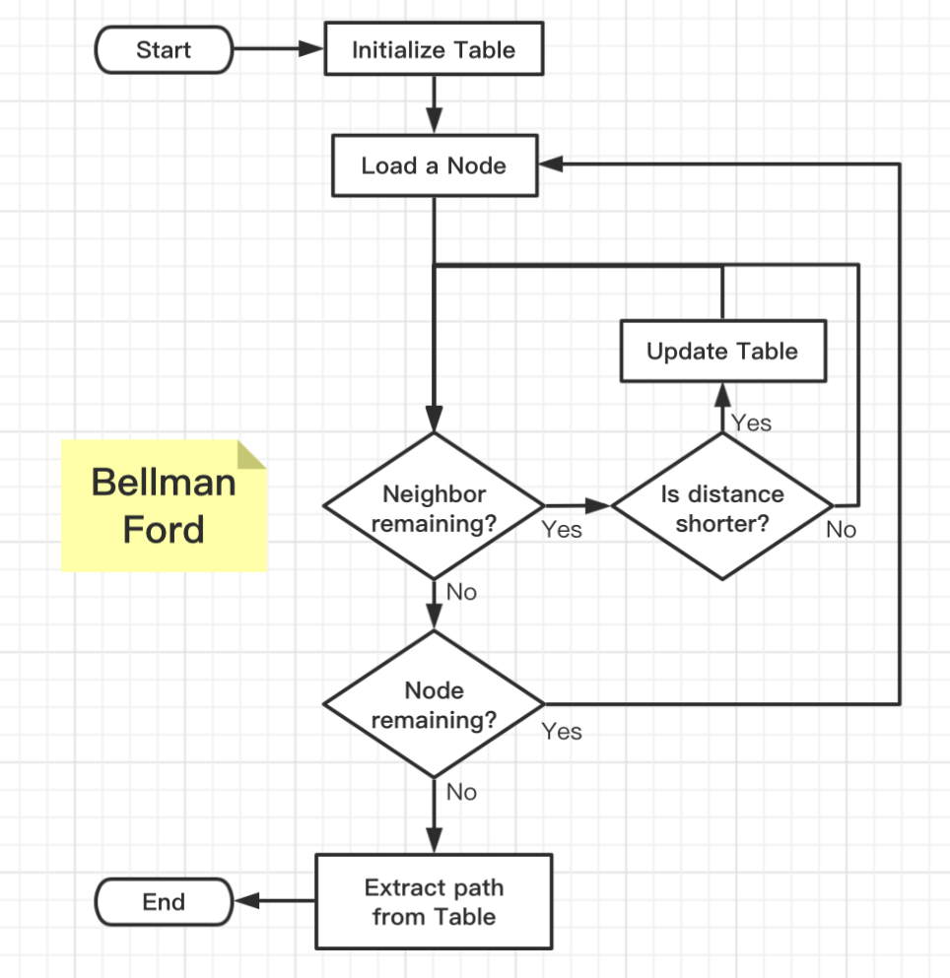

Bellman-ford
What is the Table?
Good searching method
Store distance information
Store node information
How to initialize the Table?
Set all the other nodes to INFINITY
Set the start node distance to 0
Optimization
When to update the Table?
When encounter a node that distance is smaller than stored.
How to know distance is shorter?
Calculate the distance to neighbor
Add current node distance away from root
Compare to the neighbor distance

Slide 16
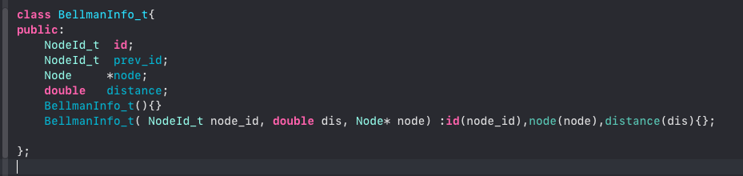
Bellman-ford
Here is the data structure that used to store information for each node.
We view this as a unit stored in our table. The key combined with this unit is the id of the specific node. Therefore we use map to impliment out table.

Slide 17
Bellman-ford
Optimization:
No need to iterate all the node
Stop when no other distance updated
Starting from the node that previously updated
How?
A data structure can store information as the order we proceed
A data structure can pop out the previous data as we go further
A data structure can perform in the way of first in first out.
We use queue!!!
When update a node, put it into the queue.
When iterate a node, pop one from the queue.
The queue always store the data that is updated from the previous iteration.
When the queue is empty, we stop. Because no additional node is updated.

Slide 18
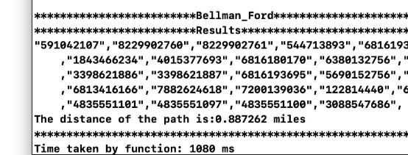
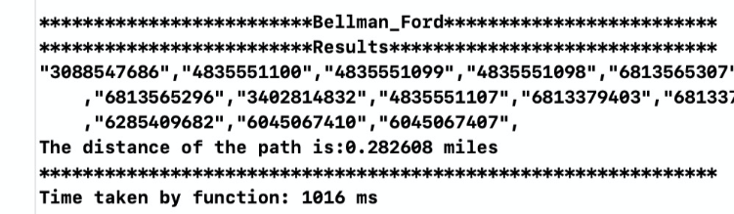
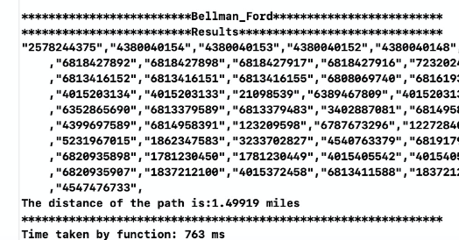
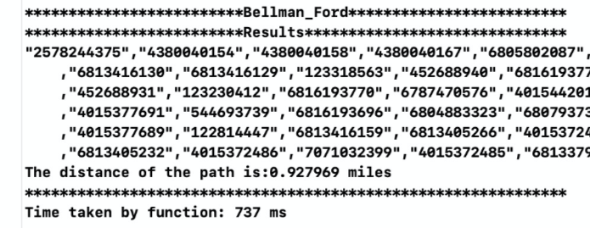
Bellman-ford
Here are some results for Bellman-Ford algorithm.
Time: O(VE)

Slide 19
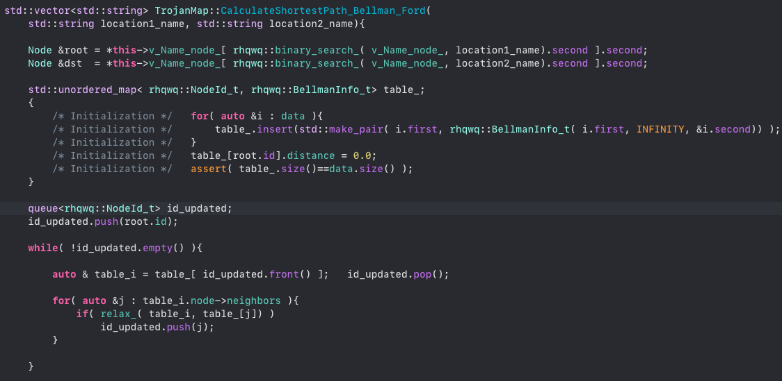
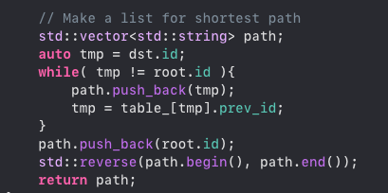
Bellman-ford

Slide 20
OUTLINE
Self-Implementation
Auto Complete Name / Closest name / Find Location
Bellman Ford Shortest Path
Dijsktra Shortest Path
Travelling Salesman Problem

Slide 21
Dijkstra

Slide 22
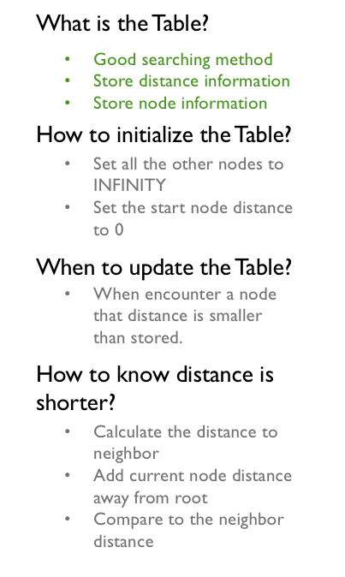
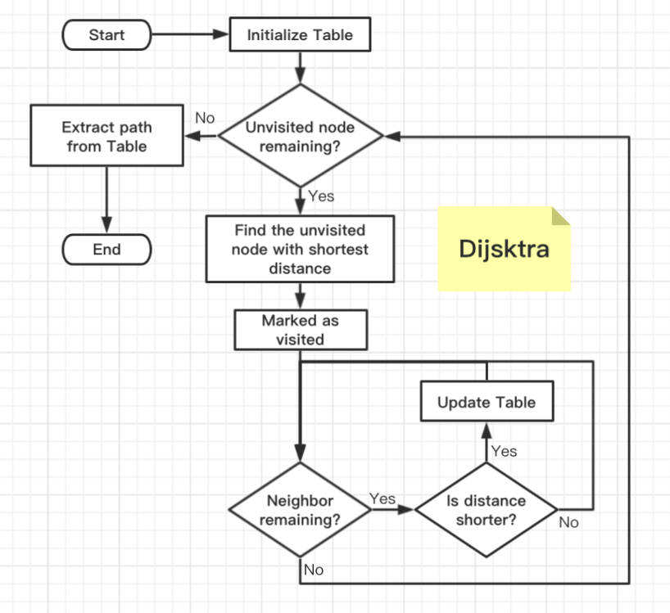
DIJKSTRA
Similar with Bellman Ford
How to find the unvisited node with shortest distance?
Use priority queue!!!

Slide 23
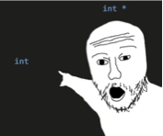
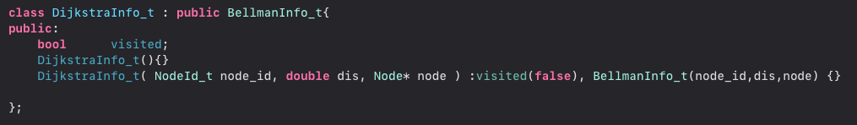
DIJKSTRA
Here is the data structure that used to store information for each node.
Simply inherit from Bellman-Ford
We need a boolean flag to mark visited node.
Again, we view this as a unit stored in our table. The key combined with this unit is the id of the specific node. Therefore we use map to impliment out table.

Slide 24
DIJKSTRA QWQ
Here are some results for Dijkstra algorithm.
Time: O((V+E)log V)

Slide 25
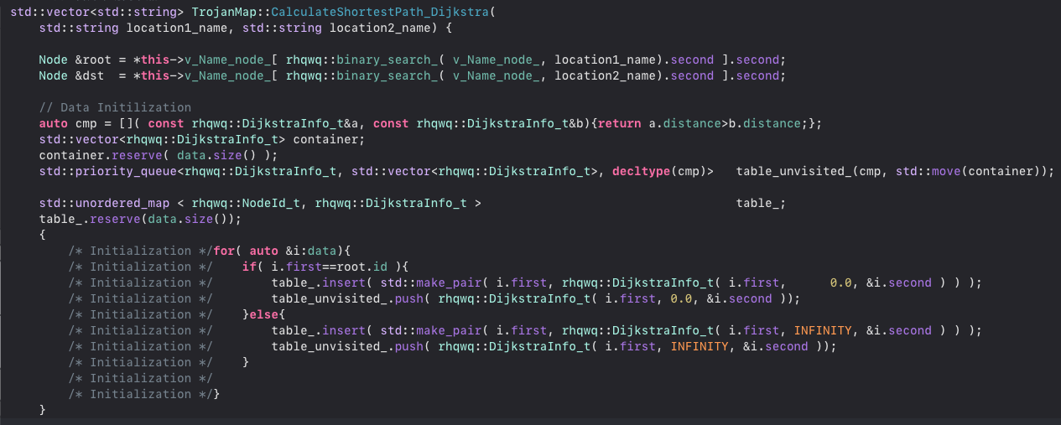
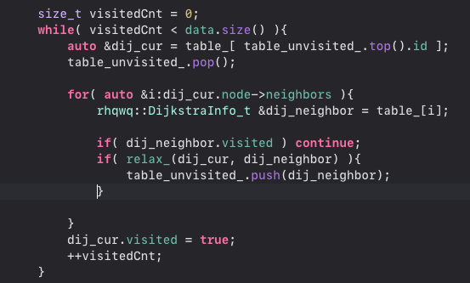
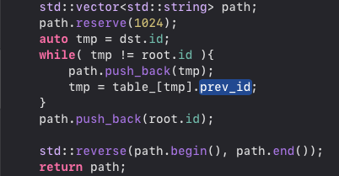
DIJKSTRA

Slide 26
OUTLINE
Self-Implementation
Auto Complete Name / Closest name / Find Location
Bellman Ford Shortest Path
Dijsktra Shortest Path
Travelling Salesman Problem

Slide 27
TRAVELLING SALES MAN

